Slide 1
Serial time-encoded amplified image for real-time observation of fast dynamic phenomena
PD Yi-Da Hsieh

Slide 2
Introduction
Optical imaging is a widespread and versatile diagnostics and inspection tool in use today.
High-speed optical imaging is an effective tool for real-time observation of fast dynamical events such as shokwaves, laser fusion.

Slide 3
Introduction
<1M fps
Serial time-encoded amplified imaging/microscopy (STEAM) .
Ref: http://www.sony.jp/cyber-shot/products/DSC-WX1/feature_1.html

Slide 4
Dispersive Fourier transformation (DFT) (分散フーリエ変換)
A sufficiently large and linear GVD
As a gain medium.
Ref: K. Goda, et al. (2013) Nat. Phontonics, 7: 102.

Slide 5
Method for DFT
~1,550 nm
800–1,000 nm

Slide 6
Gas spectroscopy
Spectral width: 600nm
Mode-locked ytterbium fiber laser
Center wavelength: 1064nm.
Repetition rate: 1.133MHz
10 GHz bandwidth photodiode
8 GHz bandwidth real-time oscilloscope
Ref: J. Hult, et al. (2007) Opt. Exp., 15: 11385.

Slide 7
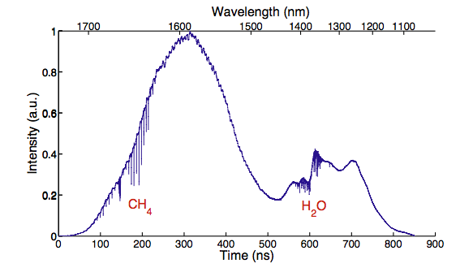
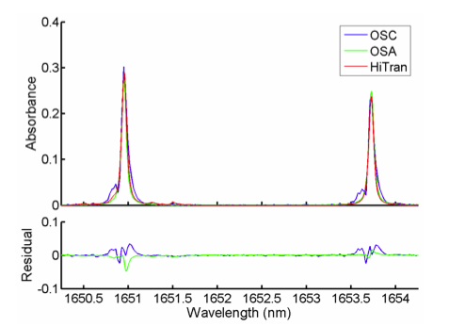
Broadband absorption spectrum of a gas mixture (CH₄ and H₂O)
Average of 1000 wavelength sweeps
Total acquisition time: 0.9ms
Spectral resolution: 39pm

Slide 8
STEAM camera
Ref: K. Goda, et al. (2009) Nature, 458: 1145.

Slide 9
2D spatial disperser

Slide 10
Basic operation of the STEAM camera.

Slide 11
The laser ablation experiment
Temporal resolution: 163ns

Slide 12
High-throughput single-microparticle imaging flow analyzer
Ref: K. Goda, et al. (2012) Proc. Natl. Acad. Sci., 109: 11630.

Slide 13
High-throughput single-microparticle imaging flow analyzer

Slide 14
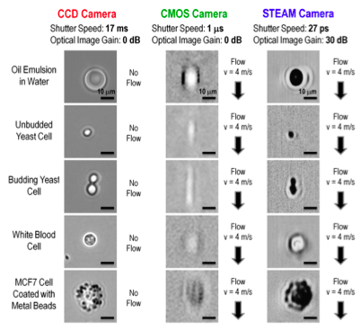
Comparison with a conventional CCD camera and a CMOS camera

Slide 15
Rare Cell Detection
MCF7 (breast cancer cell) in blood
Red blood cells are lysed with a hypotonic lysing agent.
MCF7 cells are fixed with formaldehyde and coated with metal beads with a diameter of 1 μm via an antibody to EpCAM

Slide 16
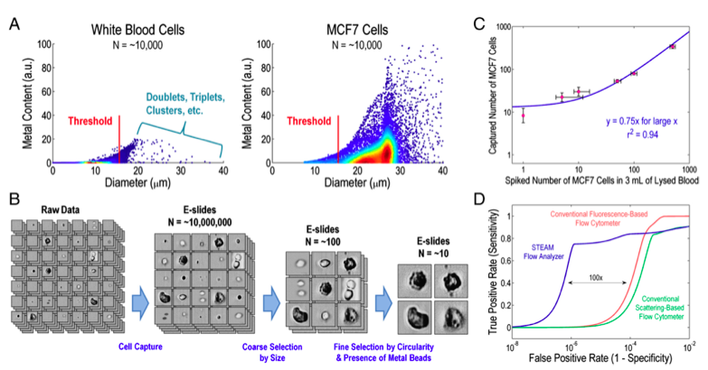
Result
Sensitivity: 75%
100,000 cells/s

Slide 17
Summary
High-speed instruments capable of capturing fast transient events are seeing increasing demand as the physical processes of interest become more complex.
With its ability to perform fast continuous measurements, STEAM is expected to be useful for high-throughput screening and studying non-repetitive rare phenomena.

